Slide 1
Generative Adversarial Network GAN-DCGAN-CGAN-CycleGAN
JingTian Zhang
Advisor: Professor Beilun Wang
July 4th, 2019

Slide 2
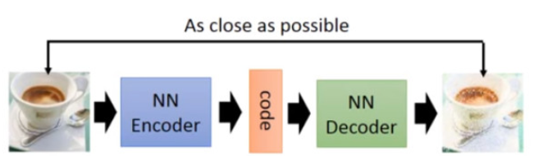
Background: Auto-encoder
Generation？
Notes:
The model learns some data and generates similar data.
Reduce dimension

Slide 3
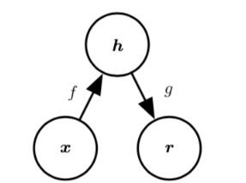
Background: Auto-encoder
undercomplete autoencoder
f and g are a pair of inverse function.
Notes:
We can use a multilayer perceptron, which we usually call it Deep neural network
The first model is undercomplete autoencoder.
look at the picture
f is encoder and g is decoder . You can think the f and g is a pair of inverse function.

Slide 4
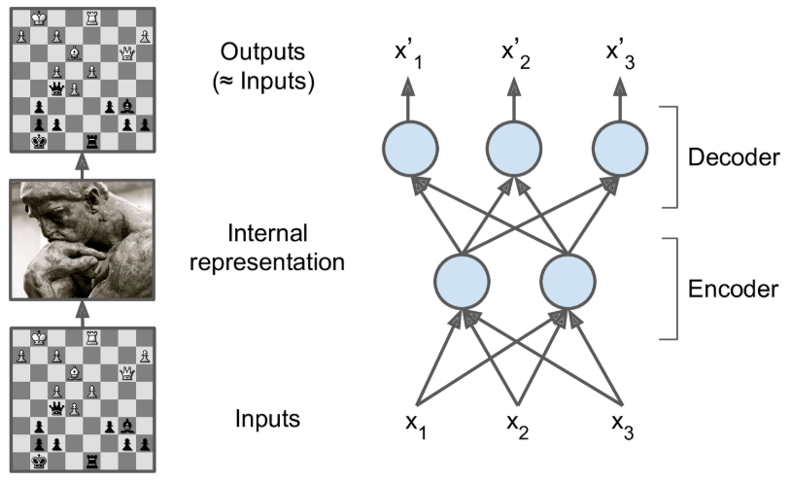
Background: Auto-encoder
undercomplete autoencoder
why undercomplete?
Notes:
why we think it is undercomplete?
Because we want to learn to reduce the dimension of the data presentation.
The internal representation has a smaller dimension than the input. So inevitably we should discard some unimportant information.
Here is a vivid example. Chess master- layout of the chess – experience – reduce dimension
记忆（memory）、感知（perception）、和模式匹配（pattern matching）

Slide 5
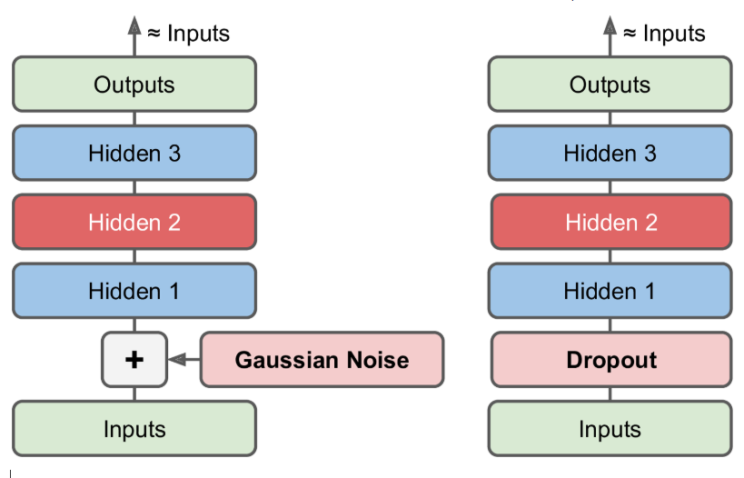
Background: Auto-encoder
More Useful Net
denoising
autoencoder
Notes:
Denoising autoencoder (DAE) is a type of autoencoder that receives damaged data as input and is trained to predict original undamaged data as input.

Slide 6
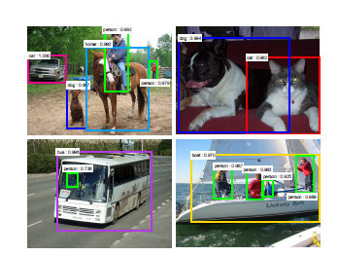
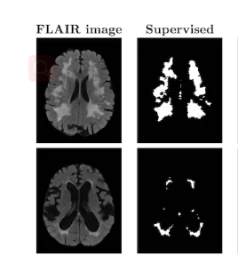
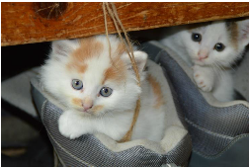
Background: Deep learning is widely used
* Classification
* Object Detection
* Image segmentation
Notes:
Deep learning is widely used in Classification, Detection, image segmentation.

Slide 7
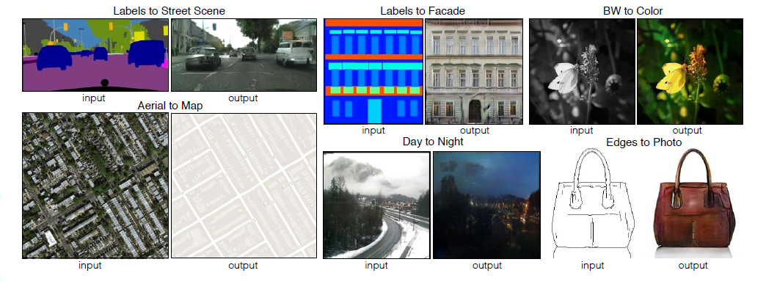
Background: Generator Image
Generator Image （Label、Style、Color、Edges）
Notes:
Many problems in image processing, graphics, and vision involve translating an input image into a corresponding output image. These problems are often treated with application-specific algorithms, even though the setting is always the same: map pixels to pixels. Adversarial nets are a general-purpose solution that appears to work well on a wide variety of these problems.

Slide 8
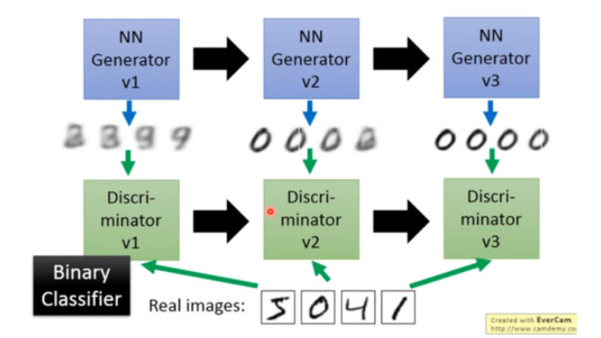
Idea: Adversarial Network
Generative model G that captures the data distribution.
Discriminative model D that estimates the probability that a sample came from the training data rather than G
Notes:
So Ian Goodfellow, who proposed a generative adversarial network
The idea is from Two-way Game.(双边博弈)

Slide 9
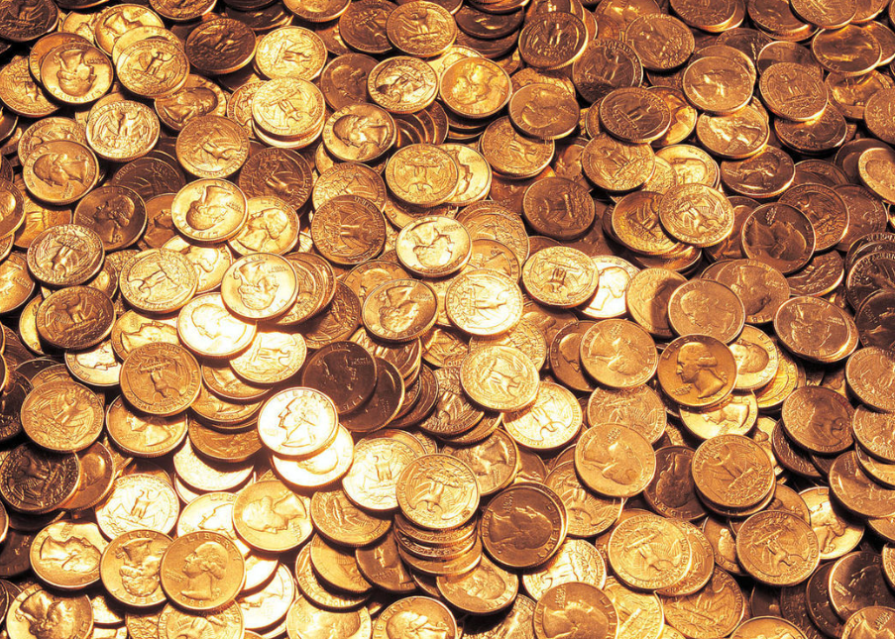
Idea: Adversarial Network
Understand easily:
generative model -> counterfeiters
discriminative model -> the police
Notes:
Counterfeiters improve their ability to produce truer money, so that they can cheat the police.
The police have improved their ability to detect counterfeit money, so that they can distinguish fake money.
Counterfeiters and the police are improved together.

Slide 10
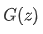
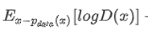
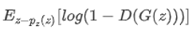
Formulation: Maxmin-Game function
: Generator’s output. generator’s data space.
: Discriminator’s output . ->1 or 0
Explanation
the sample is taken from the P_data(x) distribution
the sample is taken from the generator(x) distribution.
Notes:
we define D(x) discrimination to see if the sample is taken from the P_data(x) distribution.
to maximize the value of this entry, we need to make the D(x) close to 0, so that means that the generator is not cheating D

Slide 11
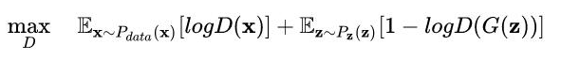
Formulation: Maxmin-Game function
Discriminator’s target maxD(x)->1 minD(G(z))->0
Generator’s target maxD(G(z))

Slide 12
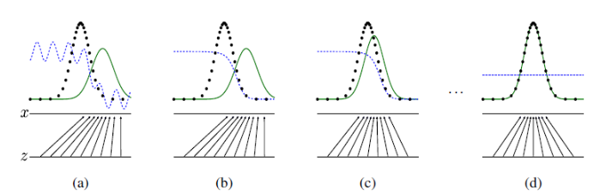
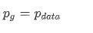
Formulation: Maxmin-Game function Graph
this minimax game has a global optimum for
Notes:
which means generation’s distribution is same raw data’s distribution.
黑点为 样本​分布， 绿线为生成分布​， 蓝点为Optimization​，最终​等于​ D = ½
coincide black green

Slide 13
Train: Alternate iteration
The whole training is an iterative process. In fact, minimax game can be understood separately.
Alternate training D and G.
Notes:
given G, maximize V and take D, fix D, and minimize V to get G. Where, given G, maximizing V evaluates the difference or distance between P_G and P_data.
，有一个一代的 generator，它能生成一些很差的图片，然后有一个一代的 discriminator，它能准确的把生成的图片和真实的图片分类，简而言之，这个 discriminator 就是一个二分类器Binary-classifier，对生成的图片输出 0，对真实的图片输出 1。 接着，开始训练出二代的 generator，它能生成稍好一点的图片，能够让一代的 discriminator 认为这些生成的图片是真实的图片。然后会训练出一个二代的 discriminator，它能准确的识别出真实的图片，和二代 generator 生成的图片。以此类推，会有三代，四代.....n 代的 generator 和 discriminator，最后 discriminator 无法分辨生成的图片和真实图片，这个网络就拟合了。

Slide 14
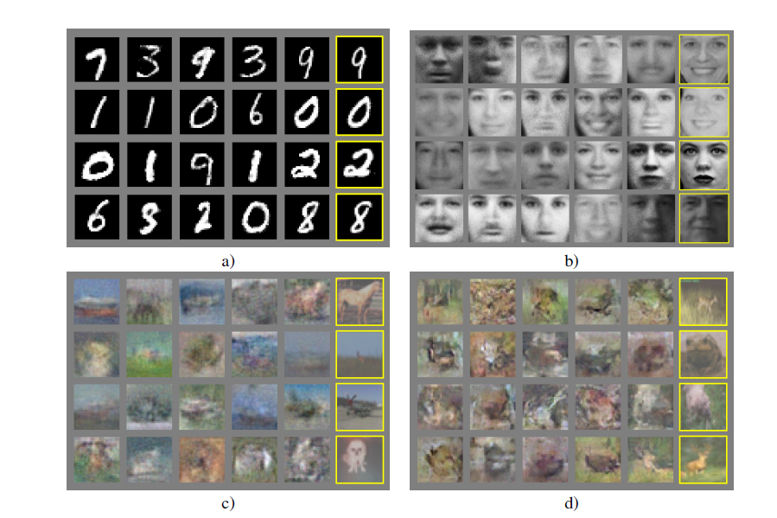
Result: GAN

Slide 15
GANs Problems:
unstable
limited in understand and visualize what GANs learn
noisy
difficult to understand
we want to know the intermediate representations of multi-layer GANs
So we research the deep convolutional GAN (DCGAN)
and Conditional GAN.
Notes:
GANs have been known to be unstable to train, often resulting in generators that produce nonsensical outputs. There has been very limited published research in trying to understand and visualize what GANslearn, and the intermediate representations of multi-layer GANs
Because GANs input is noisy, which is always gaussian noise. You can image how difficult the thing is to use a random noise to generate a specific data.

Slide 16
How to solve it?
Conditional GANs
But we still follow the process of history.
So the next part is deep convolutional GANs (DCGANs)

Slide 17
DCGANs Contribution:
Stable Training
propose and evaluate a set of constraints on the architectural topology of Convolutional GANs.
Visualize the filters learnt by GANs
Interesting vector arithmetic properties
allowing for easy manipulation of many semantic qualities of generated samples.
Notes:
the next slides will explain these contribution.

Slide 18
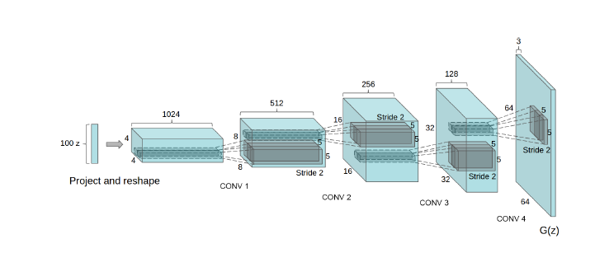
Stable Training 1:
All Convolutional Net
Using strided convolutions and fraction-strided convolution to replace any pooling layers
Notes:
Multilayer perceptron \ any loss function

Slide 19
Stable Training 2:
Remove fully connected layer
To learn more features.

Slide 20
Stable Training 3:
Batch Normalization
stabilizes learning by normalizing the input to each unit to have zero mean and unit variance
This helps deal with training problems that arise due to poor initialization and helps gradient flow in deeper models. This proved critical to get deep generators to begin learning, preventing the generator from collapsing all samples to a single point which is a common failure mode observed in GANs.
Directly applying batchnorm to all layers. however, resulted in sample oscillation and model instability. This was avoided by not applying batchnorm to the generator output layer and the discriminator input layer.
Notes:
oscillation 震荡

Slide 21
Stable Training 4:
Output layer Tanh \ Generator except output, other ReLU \ Discriminator all layer LeakyReLU
We observed that using a bounded activation allowed the model to learn more quickly to saturate and cover the color space of the training distribution.

Slide 22
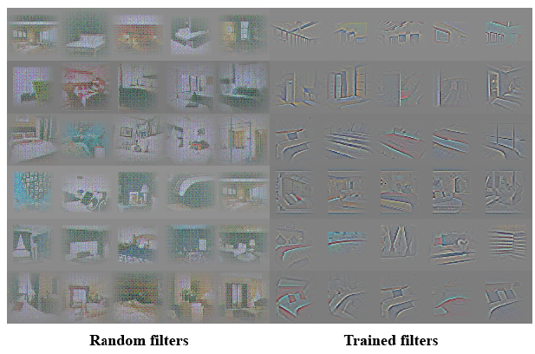
Visualize the filters
We can use filters’ frequency distribution to visualize the feature learnt in the data.
Guidance
Notes:
Help to guide us to optimize the parameter

Slide 23
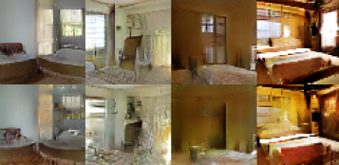
vector arithmetic properties
1. To get the generator representation.
windows -> logistics ->dropout -> generator
Notes:
The first thing is to know the representation of feature

Slide 24
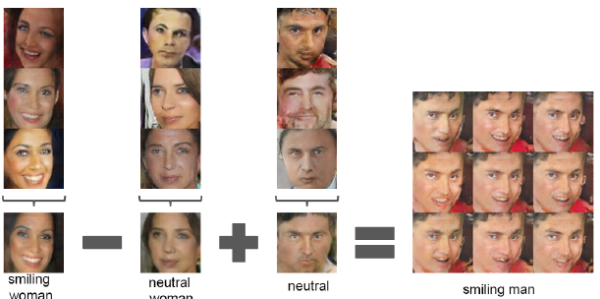
vector arithmetic properties
2. Vector arithmetic
word2vec - linear structure
vector(“king”) – vector(“man”)
+ vector(“woman”)
= vector(“queen”)
Face in space Z is linear.

Slide 25
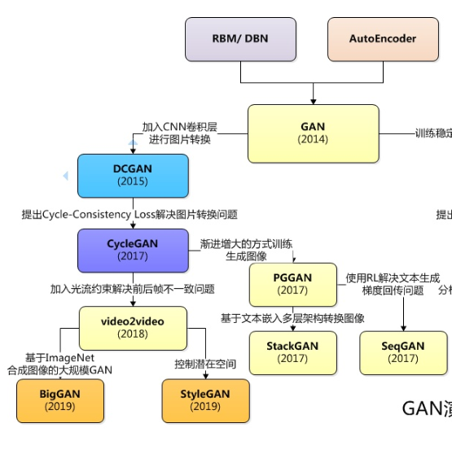
Future: Do more things on the base of DCGANs
Pix2Pix (Conditional GAN)
CycleGANS
Video2video
BigGAN
StyleGAN

Slide 26
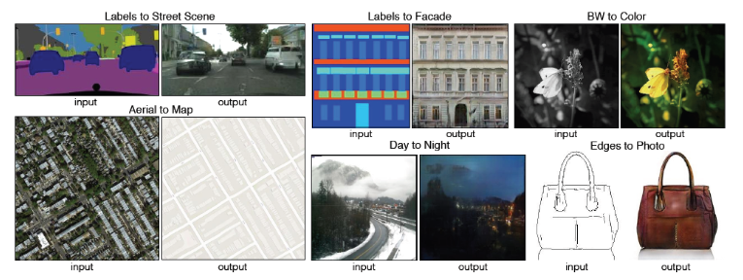
Pix2Pix(Conditional GANs)
Many problems can be posed as “translating” an input image into a corresponding output image.
Notes:
Many problems in image processing, computer graphics, and computer vision can be posed as “translating” an input image into a corresponding output image.

Slide 27
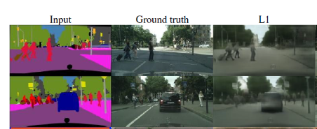
The problems in CNN
Designing effective losses
naïve loss like Euclidean distance will cause blurring
Notes:
CNNs learn to minimize a loss function – an objective that scores the quality of results – and although the learning process is automatic, a lot of manual effort still goes into designing effective losses.
If we take a naive approach and ask the CNN to minimize the Euclidean/ju:'klidiən/
distance between predicted and ground truth pixels, it will tend to produce blurry results. This is because Euclidean distance is minimized by averaging all plausible outputs, which causes blurring.
（还是有点没解释清楚，）

Slide 28
DCGAN and CGAN
DCGAN’s loss is an auto-learning function.
CGAN
Structured losses for image modeling.
penalty for structure
Conditional
using label , text, image to bound GANs.
GANs can receive any data, like noise, image, feature.
CGANs use another input to limit train.

Slide 29
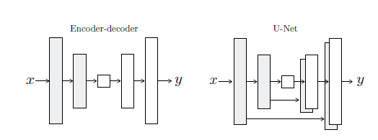
Net Structure
Generator:
“U-Net”
Discriminator:
Convolutional PatchGANs
loss penalty L1 loss catch low frequency information
Each patch is independent
Markov random field in each patch
Notes:
Encoder-Decoder Network has been used, but for many image conversion problems, there is a lot of low-level information that can be Shared between input and output, and passing it directly over the Network can be helpful.Add skip connections like u-net.
PatchGANs :
The discriminator structure only punishes patch size structure. The discriminator classifies each N*N patch as true or false.
高频：信号的变化速度较快，一片图像的亮度较多且明显。

Slide 30
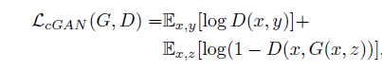
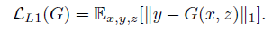
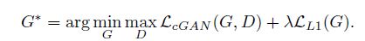
Loss Fuction:
Target Fuction
L1 Penalty
Our final objective
Notes:
Previous approaches have found it beneficial to mix the GAN objective with a more traditional loss, such as L2 distance. The discriminator’s job remains unchanged, but the generator is tasked to not only fool the discriminator but also to be near the ground truth output in an L2 sense. We also explore this option, using L1 distance rather than L2 as L1 encourages less blurring.
(为什么L1可以减少模糊？)

Slide 31
Pix2Pix Conclusion
CGAN -input as an image instead of a random vector
U-Net -use skip-connection to share more information
pair into D to guarantee the mapping
patch-D to reduce the calculation amount and improve the effect
L1 loss function is added to ensure consistency between input and output.

Slide 32
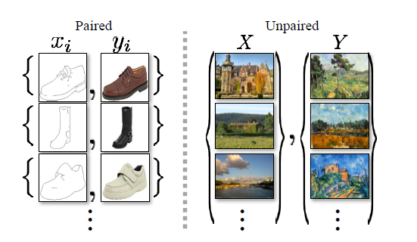
Pix2Pix’s Problems
For many tasks, paired training data will not be available.

Slide 33
CycleGANs
Image-to-image translation
Unpaired
finding a mapping
mapping between two image collections, rather than two specific images.
Notes:
Image-to-image translation is a class of vision and graphics problems where the goal is to learn the mapping between an input image and an output image using a training set of aligned image pairs.
using unpaired data , we just learn the translation of their styles. We don’t need to find paired data which is very difficult to find .
Our goal is to learn a mapping G : X->Y such that the distribution of images from G(X) is indistinguishable from the distribution Y using an adversarial loss.
Our primary focus, on the other hand, is learning the mapping between two image collections, rather than between two specific images, by trying to capture correspondences between higher-level appearance structures.

Slide 34
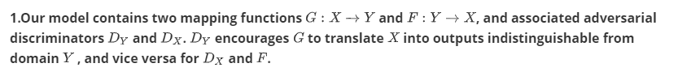
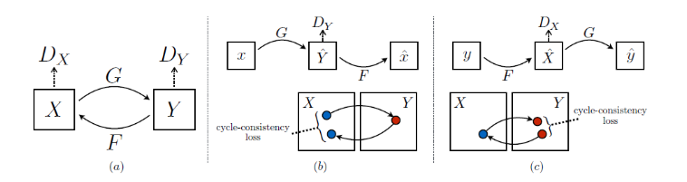
CycleGANs’ main idea:

Slide 35
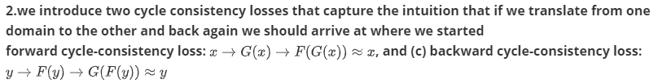
CycleGANs’ main idea:

Slide 36
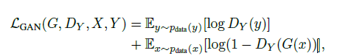
CycleGANs’ Loss:
1. Adversarial Loss (Discriminator)

Slide 37
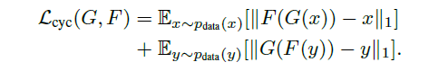
CycleGANs’ Loss:
2.Cycle Consistency Loss(Generator)
To reduce the space of mapping function, we argue that the learned mapping functions should be cycle-consistent. (cycle-consistent property)
Notes:
with large enough capacity, a network can map the same set of input images to any random permutation of images in the target domain, where any of the learned mappings can induce an output distribution that matches the target distribution. Thus, adversarial losses alone cannot guarantee that the learned function can map an individual input xi to a desired output yi. To further reduce the space of possible mapping functions, we argue that the learned mapping functions should be cycle-consistent.

Slide 38
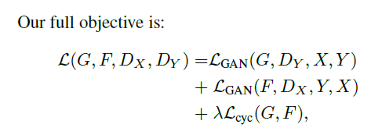
CycleGANs’ Loss:
3.Full Loss

Slide 39
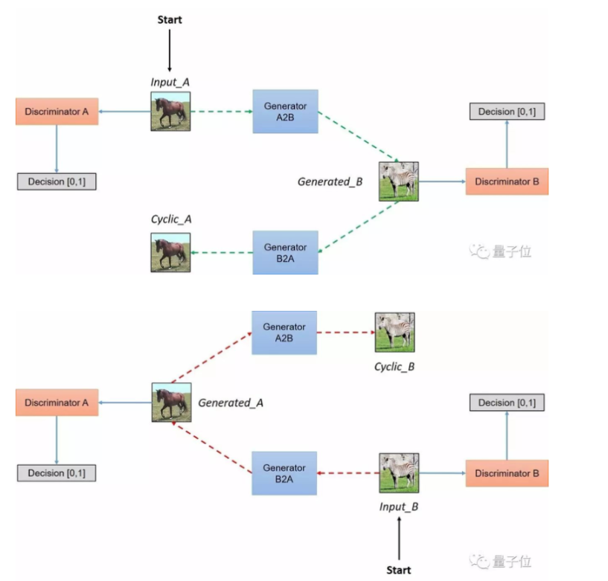
The whole cycle:

Slide 41
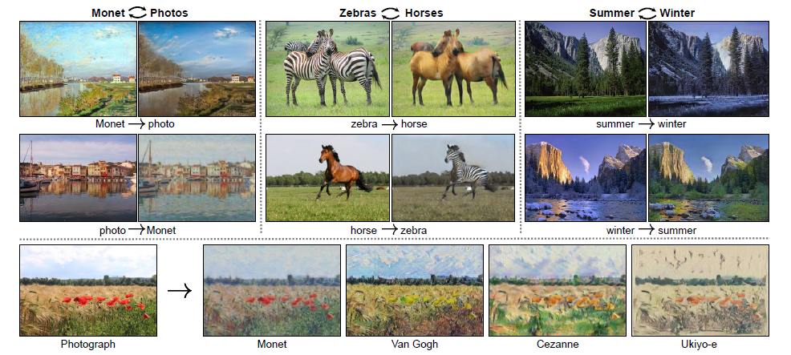
Application in CycleGANs:
Notes:
Style transfer

Slide 42
Thank you !

Slide 43
To Do
Do Experiment
Learn Video2video 、BigGAN 、StyleGAN
😄StyleGAN is very interesting.
https://www.thiswaifudoesnotexist.net/

